Slide 1
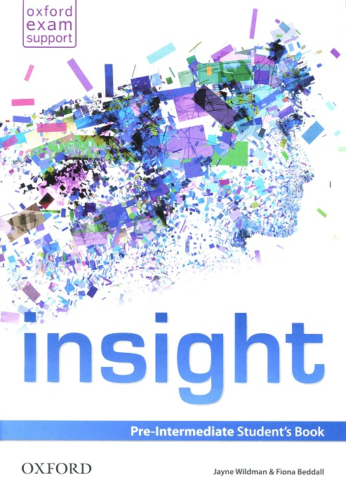

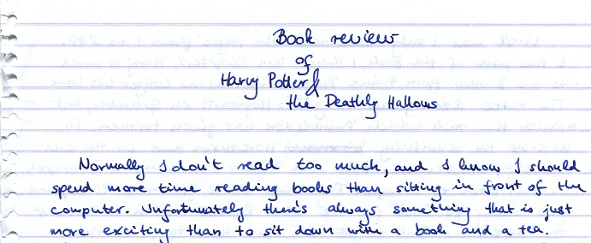
Using Literature in the EFL Classroom
Edmund Dudley

Slide 2
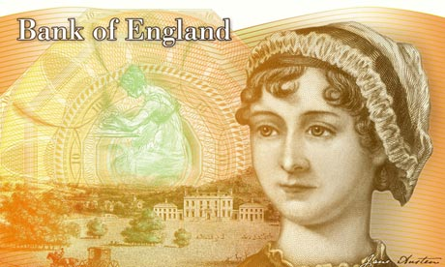
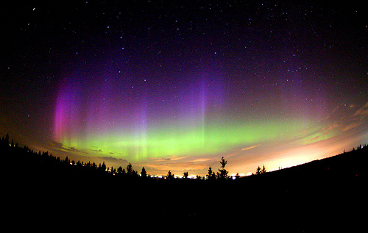

Quick Quiz
Which writer is set to appear on the £10 note from 2017?
What is the connection between Aurora Borealis and Exeter College?
Hardback sales of The Cuckoo’s Calling by Robert Galbraith rose from 43 copies to 17,662 copies in one week. Why?
2

Slide 3
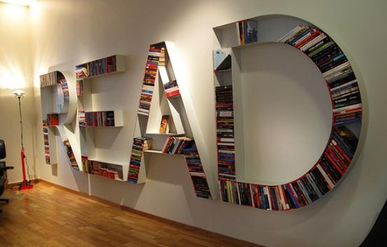
Extensive reading
Reading for pleasure
3
Professional Development
Notes:
3

Slide 4

Your reading habits
Talk to your neighbour. Find out:
What s/he prefers to read
Where s/he likes to read the most
When s/he finds time to read
How s/he prefers to read
Why s/he reads

Slide 5
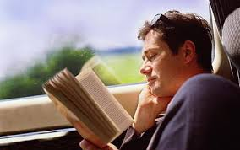
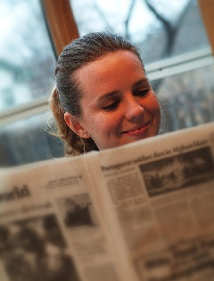
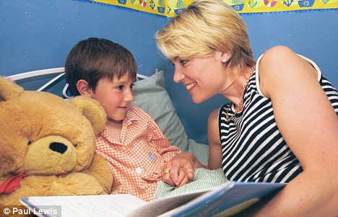
Extensive reading
When do we do it in real life?
to switch off
to browse
for fun
5
Professional Development
Notes:
5

Slide 6
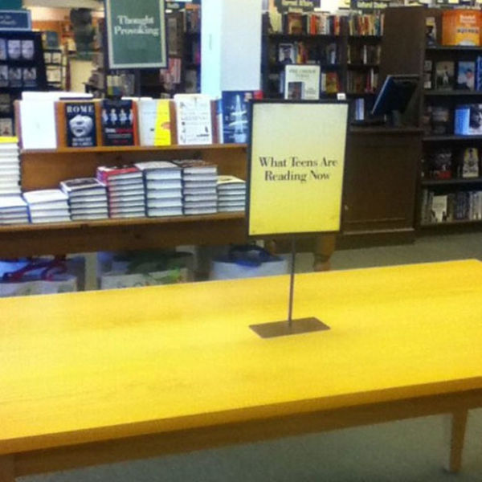
What teens are reading…

Slide 7
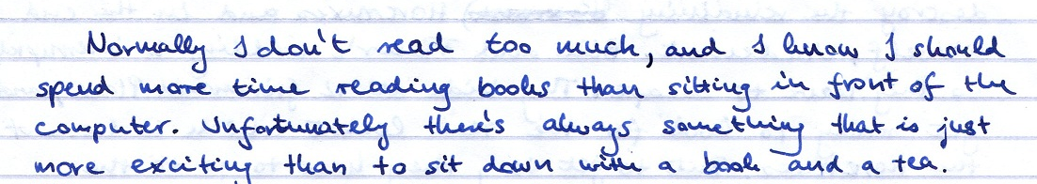
Challenges and obstacles
A 16 year-old student confesses
7
Professional Development
Notes:
7

Slide 8
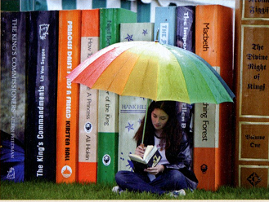
How much do your students read?
Do they read in L1?
Do they read in English?
L1 →
L2
R→ R/S/W/L
8
Professional Development
Notes:
8

Slide 9

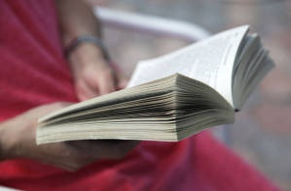
The benefits of extensive reading
“…research demonstrates that students who read extensively also make gains in overall language proficiency.”
Richard R Day
9
Professional Development
Notes:
9

Slide 10
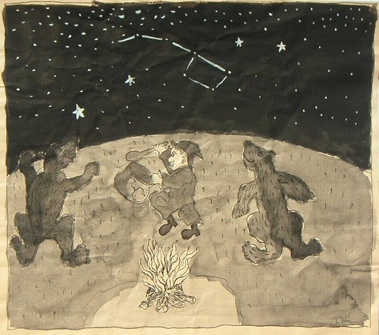

Slide 11
What is language?
A writer’s view
“Language is a cracked kettle on which we beat out tunes for bears to dance to, while all the time we long to move the stars to pity.”
G Flaubert, Madame Bovary
11
Professional Development
Notes:
11

Slide 12
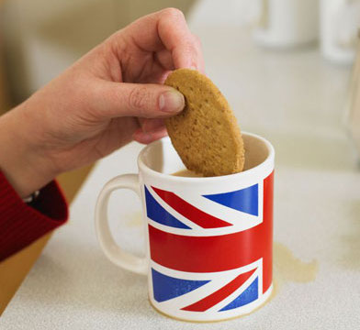

Slide 13
What is language?
A writer’s view
“Language is a traitor, a double agent who slips across borders without warning in the dead of night…It is a crippled dog, never quite able to perform the tricks we ask of it. It is a ginger biscuit, dunked for too long in the tea of our expectations, crumbling and dissolving into nothingness.”
Jonathan Coe The House of Sleep
13

Slide 14
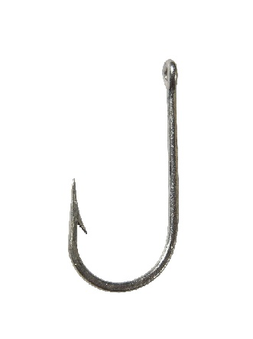

Getting students interested
Magnet and hook
14

Slide 15
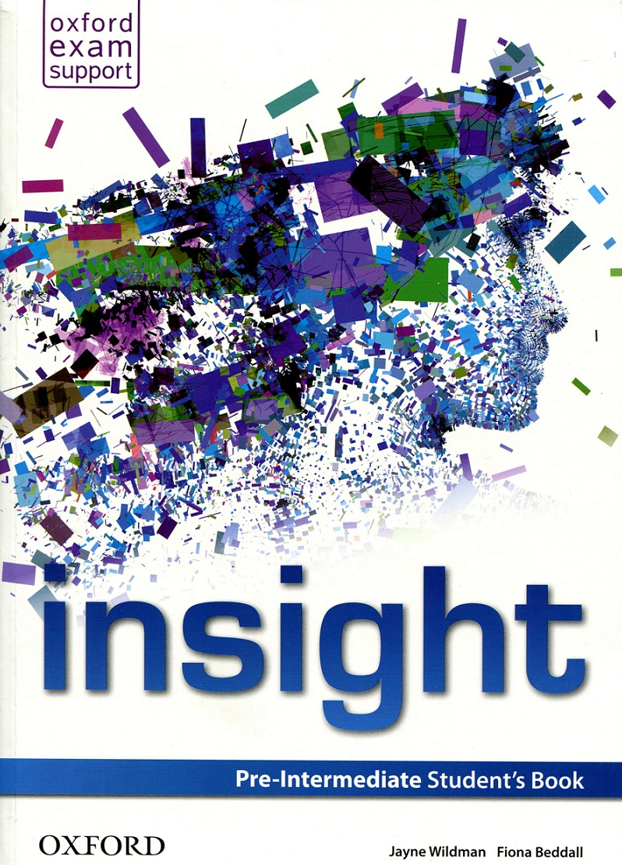
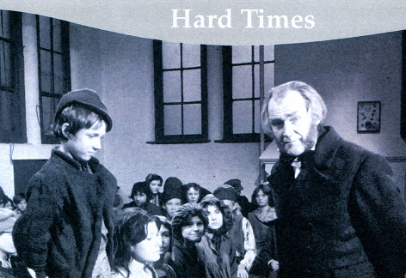
Magnet and hook
Images
Can you guess the title?
a.) Oliver Twist
b.) David Copperfield
c.) Hard Times
15
Professional Development
Notes:
15

Slide 16
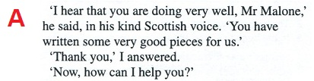

Magnet and hook
Images and text
16
Professional Development
Notes:
16

Slide 17
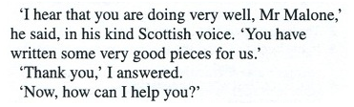

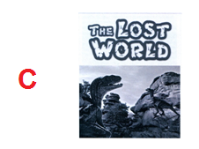
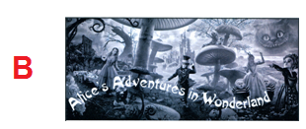
Magnet and hook
Extract and title
17
Professional Development
Notes:
17

Slide 18
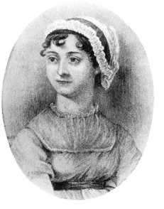
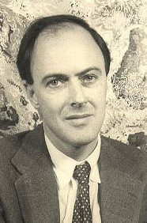
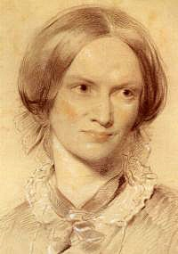
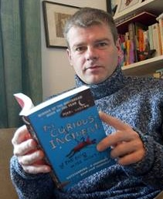




Writers in focus
Do you recognise the writers?
18

Slide 19
Writers in focus
Do you recognise the writers?
Charlotte Bronte
Mark Haddon
Roald Dahl
Jane Austen
19

Slide 20
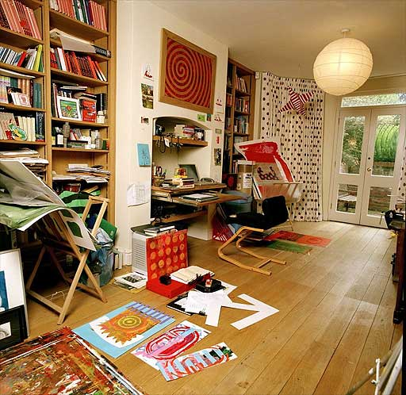
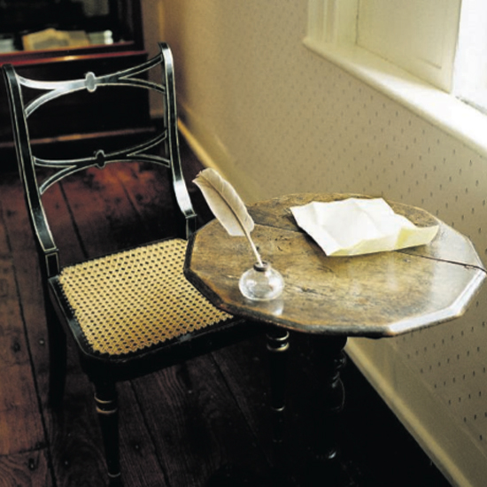
Writers’ rooms
J Austen – C Bronte – R Dahl – M Haddon
20

Slide 21
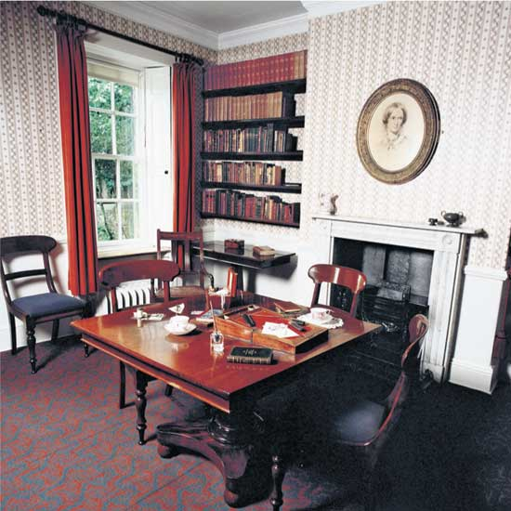
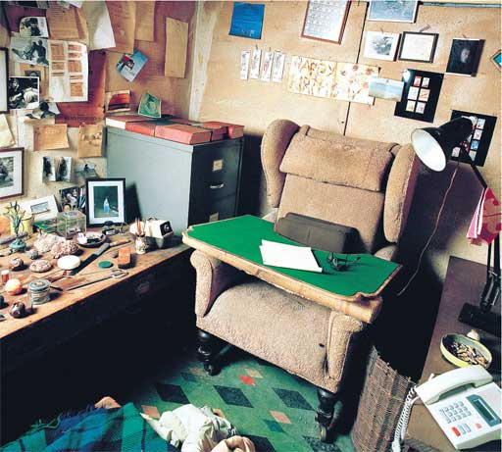
Writers’ rooms
J Austen – C Bronte – R Dahl – M Haddon
21

Slide 22
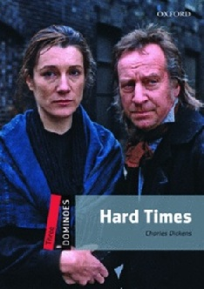


Using graded readers
Reading for pleasure
Class readers
Class library
Reading Circles
DEAR!
22

Slide 23
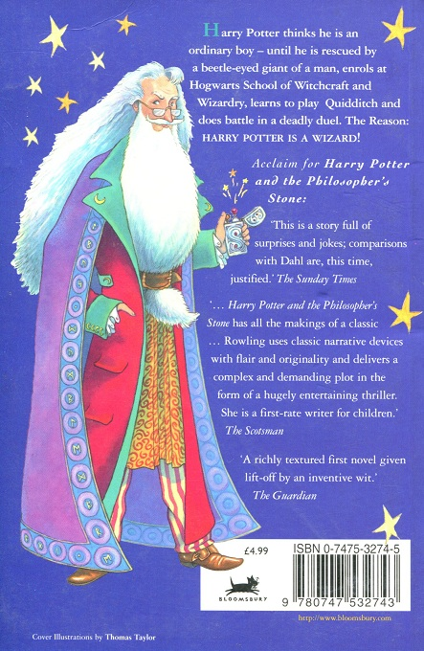
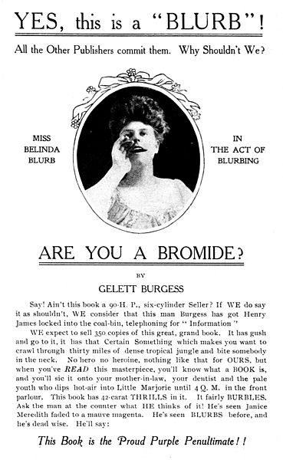
Working with blurbs
What is a blurb?
back of book
content chosen
by publisher
teaser
critical acclaim
23

Slide 24

Working with blurbs…
…you’re doing it wrong!
This novel starts with this old doctor who’s in prison in Paris, during the French Revolution of 1066. He escapes to England and then there’s this boring bit that lasts for a few hundred pages. (You can skip through some of these parts.) So the old doctor’s daughter marries this French guy, but there’s another English guy who looks just like the French guy, and he loves her, too. The French guy goes back to Paris and they put him in prison. Then they let him out. Then they put him in prison again. They want to kill him, but then the English bloke who looks just like him changes places with him and he gets killed instead. Or something like that.
24

Slide 25
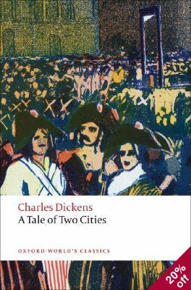
Working with blurbs
A Tale of Two Cities
Dickens' second historical novel, which he considered "the best story I have written," provides a highly-charged examination of human suffering and human sacrifice. Private experience and public history parallel one another as the political activities and personal responsibilities of these fictional characters, during the French Revolution, draw them into the Paris of the Terror.
25

Slide 26
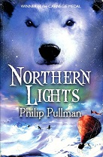

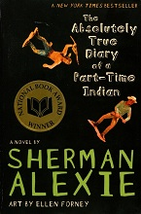



Working with blurbs
Matching
1. When sixteen-year old Tris makes her choice, she cannot forsee how drastically her life will change…
2. When Lyra’s friend Roger disappears, she and her daemon, Pantalaimon, set out to find him…
3. Junior is a budding cartoonist growing up on the Spokane Indian reservation…
26
Notes:
1B
2A
3C

Slide 27

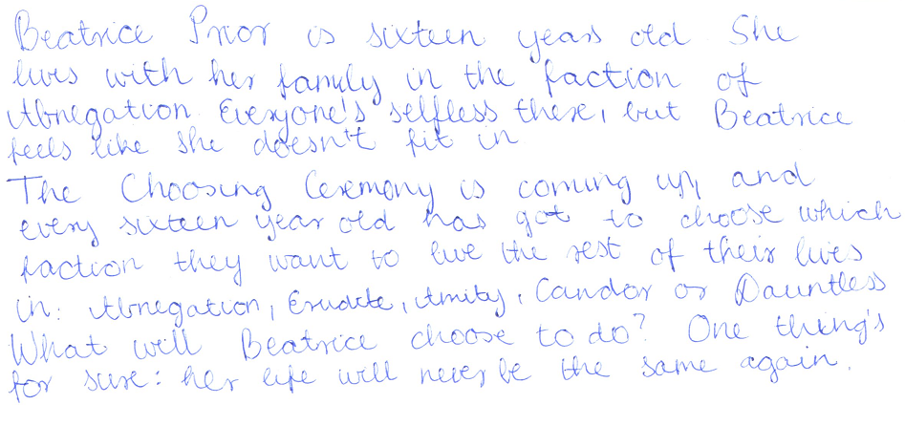
Working with blurbs
Writing
27

Slide 28

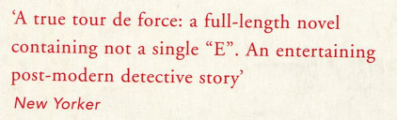
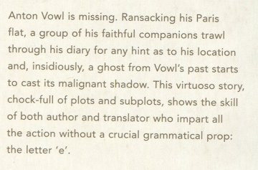
A difficult blurb to write!
Perec’s Avoid – Gilbert Adair
28

Slide 29
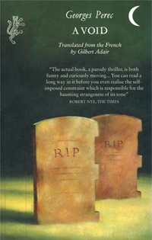
Noon rings out. A wasp, making an ominous sound, a sound akin to a klaxon or a tocsin, flits about. Augustus, who has had a bad night, sits up blinking and purblind. Oh what was that word (is his thought) that ran through my brain all night, that idiotic word that, hard as I'd try to pun it down, was always just an inch or two out of my grasp - fowl or foul or Vow or Voyal?
Lipogram
Notes:
What do you notice about this text?
Georges Perec La Disparition – written without using the letter E and – amazingly – translated into English as A Void by Gilbert Adair according to the same constraint.
A lipogram is a piece of text written according to certain self- restrictions regarding which letters the writer can and/or can’t use. Lipogram: a piece of writing from which all words containing
a particular letter have been deliberately omitted.
A further example is one we’ve already mentioned - the Hungarian game eszperente in which the only vowel you are allowed to use is the letter E.
Lipograms are clearly very difficult, so they are the kind of thing which you can take in to be marvelled at. If, however, you are feeling brave, or if your students are very talented and motivated, you could get them to try their hand at writing lipograms themselves. If it’s too hard for them to write a text without using a particular vowel, another alternative would be to restrict the use of a common consonant.
Another option is to ban the use of certain words for the duration of a particular task. A well known example of this kind of activity is the game Taboo, in which SS must try to describe a given word (e.g. school) without using certain other words (e.g. learn, teacher, student)
Might try this out quickly in pairs?
Use my compulsory phrases guided writing idea: a whisker from the beard of Charles Darwin and a warm glass of Sri Lankan mango juice
This is actually an example of the kind of task where students have to perform a lipogram of sorts. Links to the notion of freedom through constraint and is a good way of demonstrating how variety and differentiation can be brought to classroom writing tasks: more able students can be given the lipogrammatic task to make the writing activity more appealing and challenging.
29

Slide 30
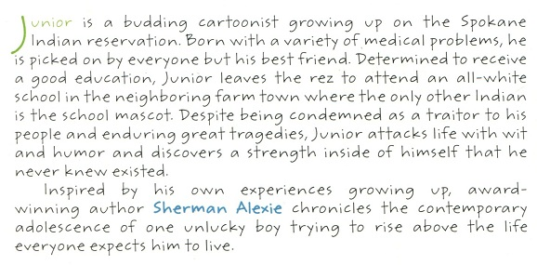
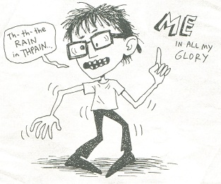
Getting ready to write
From blurbs to beginnings
30

Slide 31

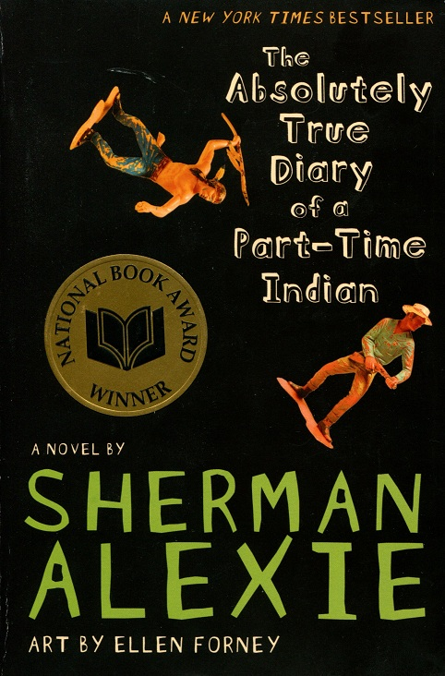







First lines
31

Slide 32
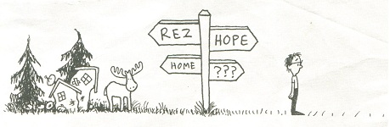
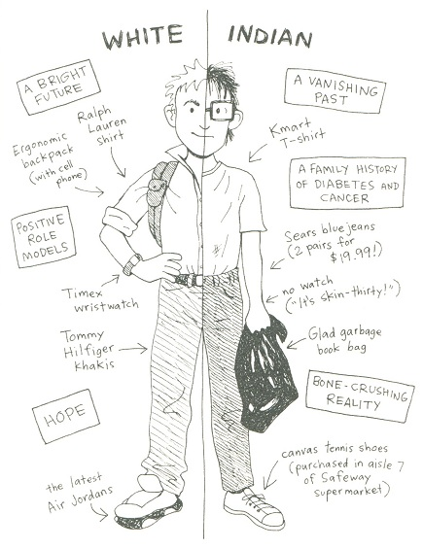
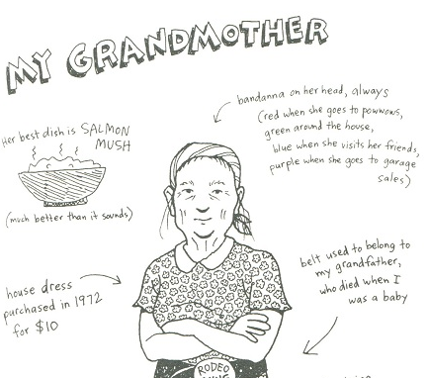
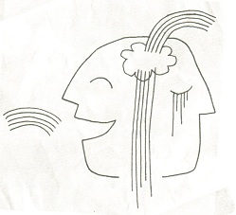
Responding to illustrations
32

Slide 33
When it comes to death, we know that laughter and tears are pretty much the same thing.
And so, laughing and crying, we said goodbye to my grandmother. And when we said goodbye to one grandmother, we said goodbye to all of them.
Each funeral was a funeral for all of us.
We lived and died together.
All of us laughed when they lowered my grandmother into the ground.
And all of us laughed when they covered her with dirt.
And all of us laughed as we walked and drove and rode our way back to our lonely, lonely houses.
33
Notes:
P166-7

Slide 34
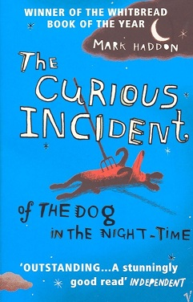
The Curious Incident
of the Dog in the Night-Time
"It's not just a book about disability... it's a book about books, about what you can do with words and what it means to communicate with someone in a book…If you met [Christopher] in real life you'd never, ever get inside his head. Yet something magical happens when you write a novel about him. You slip inside his head, and it seems like the most natural thing in the world."
Mark Haddon
34

Slide 35
A class reader
The Curious Incident...
This is a murder mystery novel.
Siobhan said that I should write something I would want to read myself. Mostly I read books about science and maths. I do not like proper novels. In proper novels people say things like, 'I am veined with iron, with silver and with streaks of common mud. I cannot contract into the firm fist which those clench who do not depend on stimulus'. What does this mean? I do not know. Nor does Father. Nor do Siobhan or Mr Jeavons. I have asked them.
Siobhan has long blonde hair and wears glasses which are made of green plastic. And Mr Jeavons smells of soap and wears brown shoes that have approximately 60 tiny circular holes in each of them.
But I do like murder mystery novels. So I am writing a murder mystery novel.
35

Slide 36
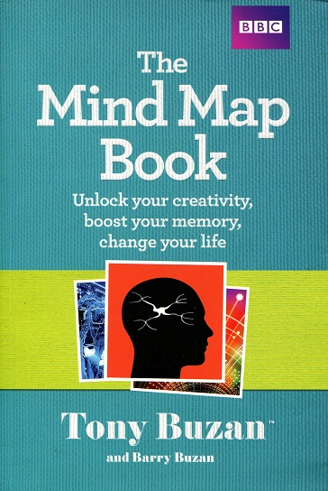
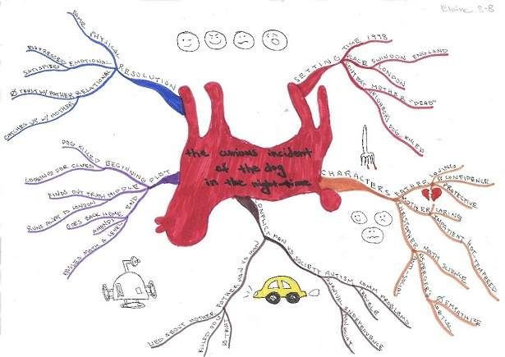
Responding to books
Mind maps
36

Slide 37
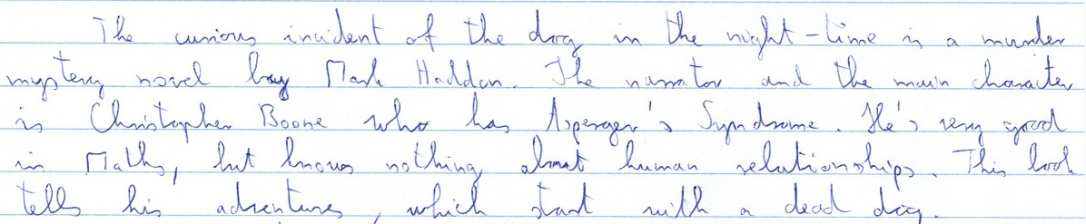
Responding to books
Reviews
1. a short summary of the plot
37

Slide 38

Responding to books
Reviews
2. focus on one interesting scene
38

Slide 39

Responding to books
Reviews
3. give your opinion of the book
39

Slide 40


Planning a written review
Paragraph plans
40

Slide 41


Planning a written review
Following a plan
41

Slide 42

Responding to books
Further follow-up activities
42

Slide 43


Sickness and cure
Type of sickness :
Cure:
43

Slide 44


44

Slide 45
Focusing on accuracy
Dictogloss
Remove the text from view
Dictate it quite slowly
Students listen and take notes
Repeat it
Students try to re-construct the text from their notes
Compare with the original
45
Professional Development
Notes:
45

Slide 46
Describing sickness
Senses poem
Do you ever feel homesick or seasick? How does it feel?
Write a senses poem.
When I am homesick,
I see…
I hear…
I smell…
I taste…
I feel…
46

Slide 47


Translate from English into L1
*wait*
Translate back from L1 into English
47

Slide 48
Stopping by Woods on a Snowy Evening
Robert Frost
Whose woods these are I think I know. / His house is in the village, though
He will not see me stopping here / To _______his woods fill up with snow.
My little horse must think it queer / To _______ without a farmhouse near
Between the woods and frozen lake / The darkest evening of the year.
He gives his harness bells a shake / To _______if there is some mistake.
The only other sound's the sweep / Of easy wind and downy flake.
The woods are lovely, dark, and deep, / But I have promises to _______,
And miles to _______before I sleep, / And miles to _______before I sleep.
48

Slide 49
Stopping by Woods on a Snowy Evening
Robert Frost
Whose woods these are I think I know. / His house is in the village, though
He will not see me stopping here / To watch his woods fill up with snow.
My little horse must think it queer / To stop without a farmhouse near
Between the woods and frozen lake / The darkest evening of the year.
He gives his harness bells a shake / To ask if there is some mistake.
The only other sound's the sweep / Of easy wind and downy flake.
The woods are lovely, dark, and deep, / But I have promises to keep,
And miles to go before I sleep, / And miles to go before I sleep.
49

Slide 50

Walking in a Winter Wonderland?
123.writeboard.com
Notes:
50

Slide 51
















Slide 52




Animal vocabulary
What do we call their young?
52

Slide 53

The Guppy
Ogden Nash
Whales have calves,
Cats have kittens,
Bears have cubs,
Bats have bittens,
Swans have cygnets,
Seals have puppies,
But guppies just have little guppies.
53

Slide 54




Predict what happens

Slide 55

The Purist
Ogden Nash
The Purist
I give you now Professor Twist,
A conscientious ____________,
Trustees exclaimed, "He never bungles!"
And sent him off to distant ____________.
Camped on a tropic riverside,
One day he missed his loving ____________.
She had, the guide informed him later,
Been eaten by an alligator.
Professor Twist could not but smile.
"You mean," he said, "a ____________."
scientist
jungles
bride
crocodile
55

Slide 56

Espresso stories
No more than 25 words
'The Dinosaur' by Augusto Monterroso
When he woke up, the dinosaur was still there.
56

Slide 57
Espresso stories online
http://espressostories.com/
'Bleeding Edge ' by Chris Williams
It was all over. It came down to who had the quickest fingers.
'This is Ned' by Zac Petrich
Ned reached out and touched Cynthia's beautiful face. It made his hand cold so he shut the freezer.
57

Slide 58

From picture to poem
Haiku
A haiku is a short poem that has:
three lines
17 syllables in total (e.g. 5-7-5)
If we want to eat
We have to sit down and think
And work together
58

Slide 59


Writing simple poems
Adverbs poem
Noun
Same N + V + Adv 1
Same N + V + Adv 1, Adv 2
Adv 1, Adv 2, Adv3
Adv 1, Adv 2, Adv 3, Adv 4
Phrase showing condition, time or place
Cars
Cars honk rapidly
Cars honk rapidly, loudly
Rapidly, loudly, annoyingly
Rapidly, loudly, annoyingly, disturbingly
In the street
59
Notes:
The adverb poem is just one of many excellent ideas for writing short, simple, highly structured poems that can be found in:
Holmes, VL and MR Moulton (2001) Writing Simple Poems CUP p32

Slide 60

60

